Slide 1


BIG DATA ANALYTICS PROJECT PHASE 1

Slide 2
TEAM MEMBERS
JASMEET KAUR DHANOTA
LAHARI KOPPOLU
KHUSHBOO DEVENDRA GOHIL

Slide 3

LAHARI KOPPOLU YEAR – 2000 DATA SOURCE Airline On Time Data
The data represents flight arrival and departure details for all commercial flights within the USA for the year 2000

Slide 4
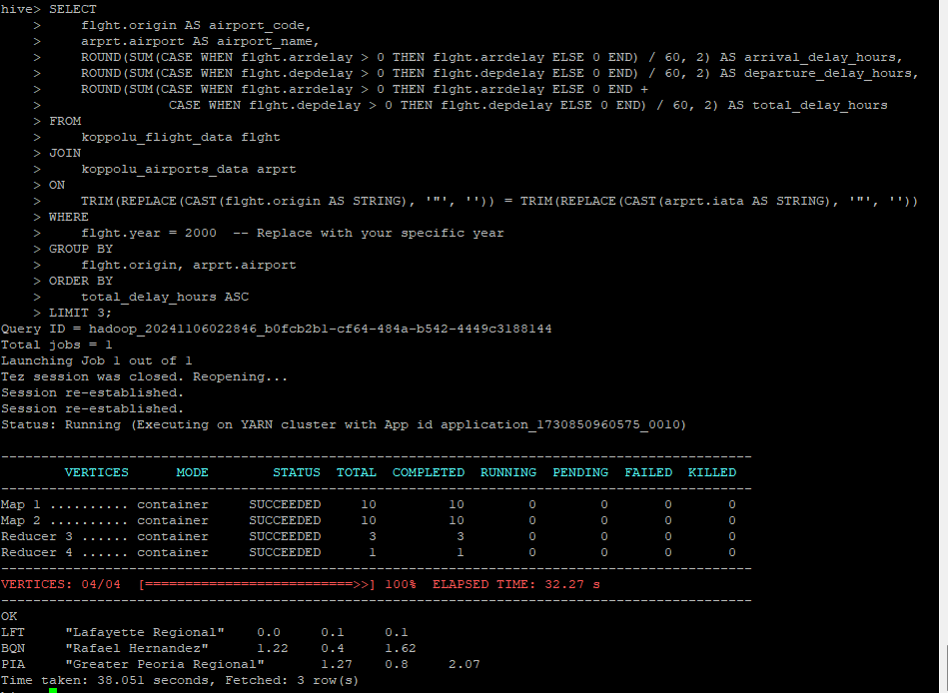
Lahari Koppolu CASE 1
Determine the three airports with the lowest delay time (in hours) in your year.

Slide 5
Lahari Koppolu CASE 1: RESULT The three airports with the lowest delay time (in hours)
YEAR | AIRCODE | ARRIVAL TIME DELAY(IN HOURS) | DEPARTURE TIME DELAY(IN HOURS) | TOTAL DELAY(IN HRS)
2000 | Lafayette Regional | 0.0 | 0.1 | 0.1
2000 | Rafael Hernandez | 1.22 | 0.4 | 1.62
2000 | Greater Peoria Regional | 1.27 | 0.8 | 2.07

Slide 6
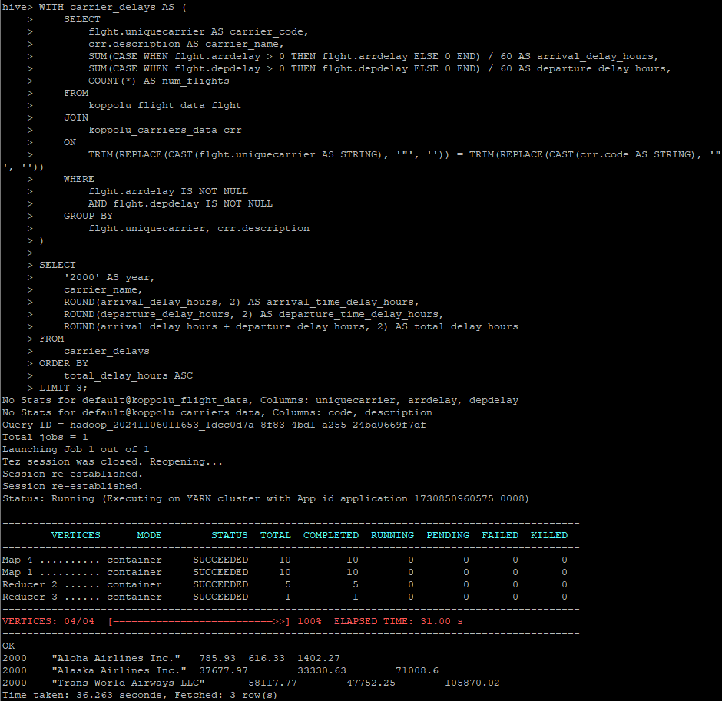
Lahari Koppolu CASE 2 Determine the three Carriers with the lowest delay time (in hours) in your year.

Slide 7
Lahari Koppolu CASE 2: Result Top 3 carriers with Lowest Delays for the year 2000 (Displayed in hours)
YEAR | CARRIER NAME | ARRIVAL TIME DELAY(IN HOURS) | DEPARTURE TIME DELAY(IN HOURS) | TOTAL DELAY (IN HOURS)
2000 | Aloha Airlines Inc. | 785.93 | 616.33 | 1402.27
2000 | Alaska Airlines Inc. | 33330.63 | 71008.6 | 104339.23
2000 | Trans World Airways LLC | 47117.77 | 47752.25 | 94870.02

Slide 8
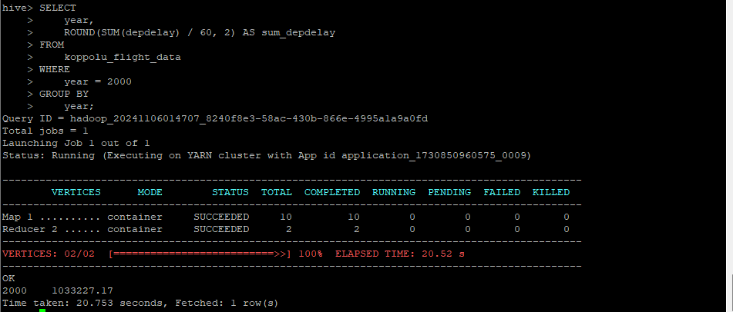
Lahari Koppolu CASE 3: Result Determine overall, which type of delay is the smallest contributor for the year 2000, Overall Departure Delays for 2000

Slide 9
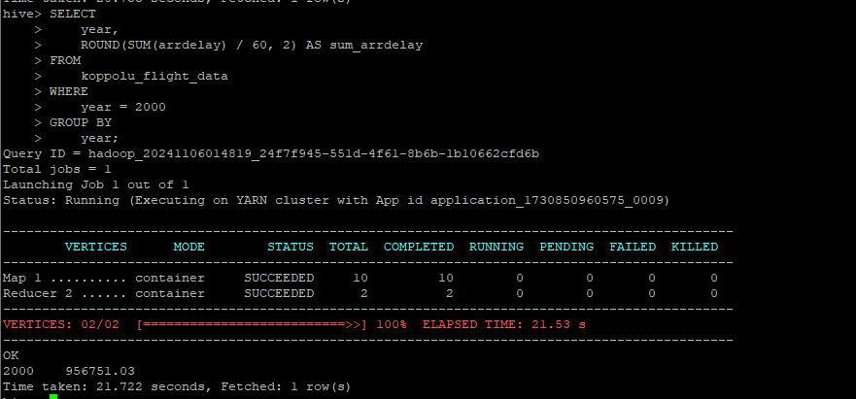
Lahari Koppolu CASE 3: Result Determine overall, which type of delay is the smallest contributor for the year 2000, Overall Arrival Delays for 2000

Slide 10
Lahari Koppolu CASE 3: RESULT Overall Arrivals was smallest contributor for year the 2000.
Departure Delay
Arrival Delay

Slide 11
TEAM CONCLUSION SLIDES

Slide 12

Airline had lowest DELAY

Slide 13
Airport Had The lowest Delay

Slide 14
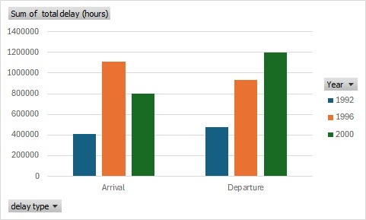
Delay Comparison

Slide 15
Conclusion
The data show that flight delays, during departure or arrival, have been consistently increasing in given years with the main effect appearing in 2000. This growth can be attributed to several factors, e.g as the increasing number of electric aircraft, changes in aviation safety paradigms Regarding delays associated with interior components, arrival-to-departure delays are greater due to factors types including how Aeroclub assets are handled during the night and landing route or destination due to weather conditions.In this light, it is conceivable that there could be recommendations for airlines that may better engage with their arrivals from a business perspective rather than a quality one with the aim of ensuring that this can be done successfully in chronological order. Furthermore, solving the waiting time problems associated with long passenger arrival times may require closer examination of these airport resources and actions for these are areas where positive changes can be identified to eliminate delays exist to increase reliable travel time.

Slide 16
THANK YOU

